Slide 1
W4153 – Cloud Computing Lecture 13: Final-Project, MDM/EDA, BPM, Kubernetes-CI-CD-DevOps
© Donald F. Ferguson, 2024

Slide 2

Contents
2 | W4153-F24-13-Final-Project-MDP/EDA-BPM-Kubernetes-CI-CD-DevOps © Donald F. Ferguson, 2024

Slide 3
Contents
Interesting questions on Ed
A quick overview of multi-tenancy
Initial final project checklist
Advanced composition
Message Driven Processing
Event Driven Architecture
Workflow, service orchestration, workflow, BPM
DevOps – A quick overview
Concepts
Infrastructure as code
CI/CD
Kubernetes
WebSocket and UI notification

Slide 4
Interesting Ed Questions
4 | W4153-F24-13-Final-Project-MDP/EDA-BPM-Kubernetes-CI-CD-DevOps © Donald F. Ferguson, 2024

Slide 5
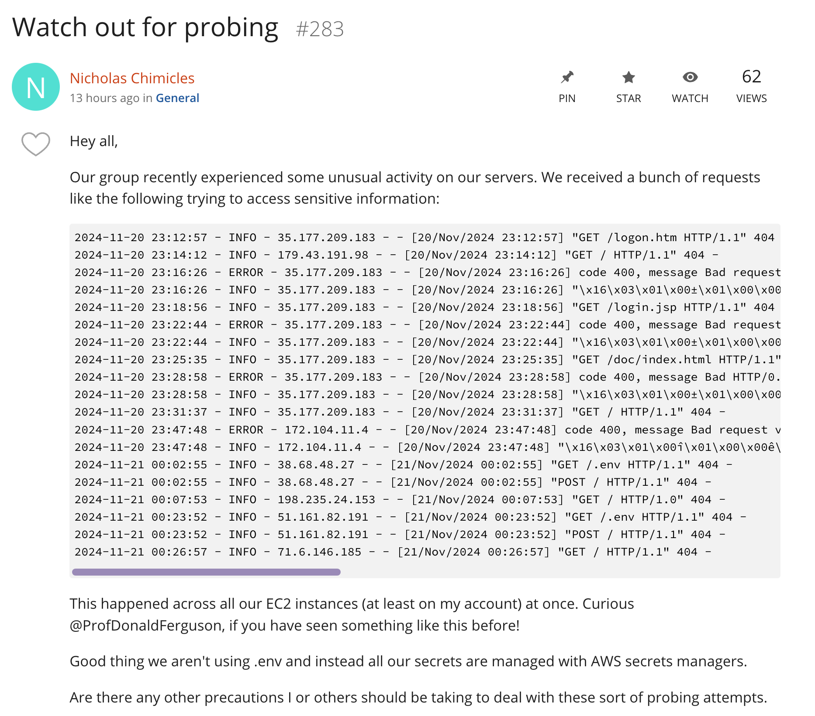
Penetration Attacks
Most organizations regularly use experts to perform a “pentest.”
If you provide an API or support a web browser application, you will be attacked. Period.
There are many, many techniques and tools that teams use.
Virtual private network.
IP address filtering and blocking.
Firewalls with request analysis rules.
Secure software development lifecycle and tools.
Data encryption.
Governance and audit.
… …
There are many documented best practices, standards, review mechanisms, etc. Independent 3rd parties perform audits.
For now – shutdown VMs, and perhaps use IP address filtering in security groups.

Slide 6
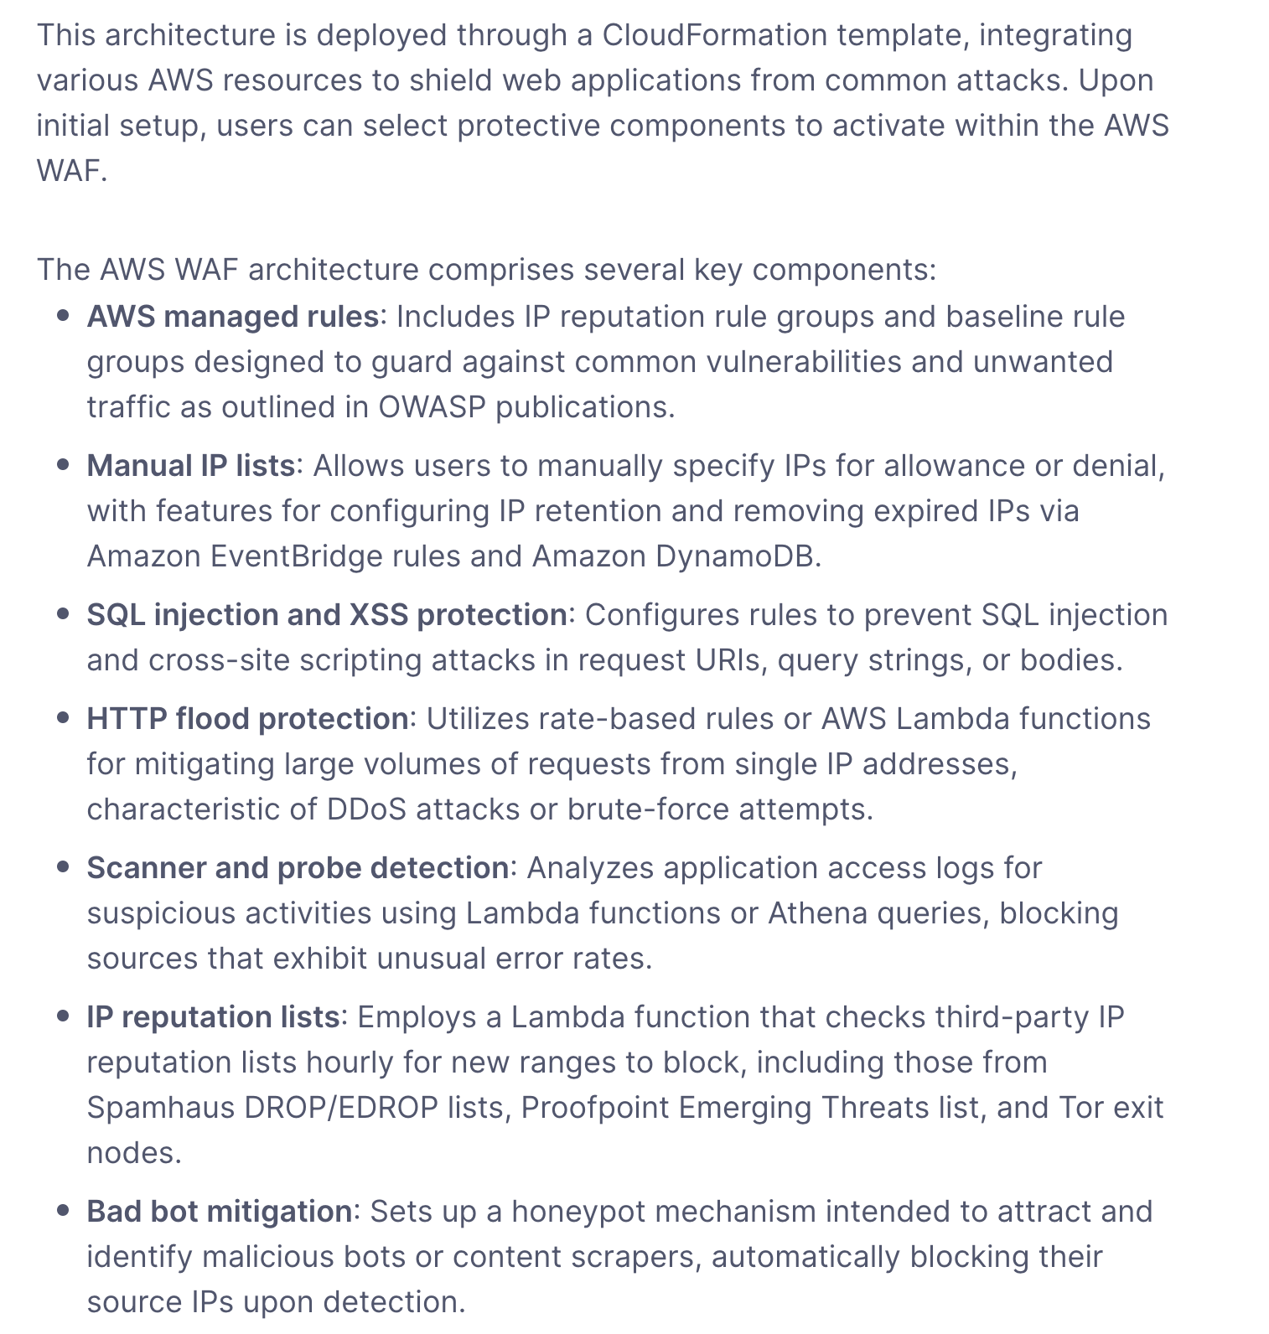
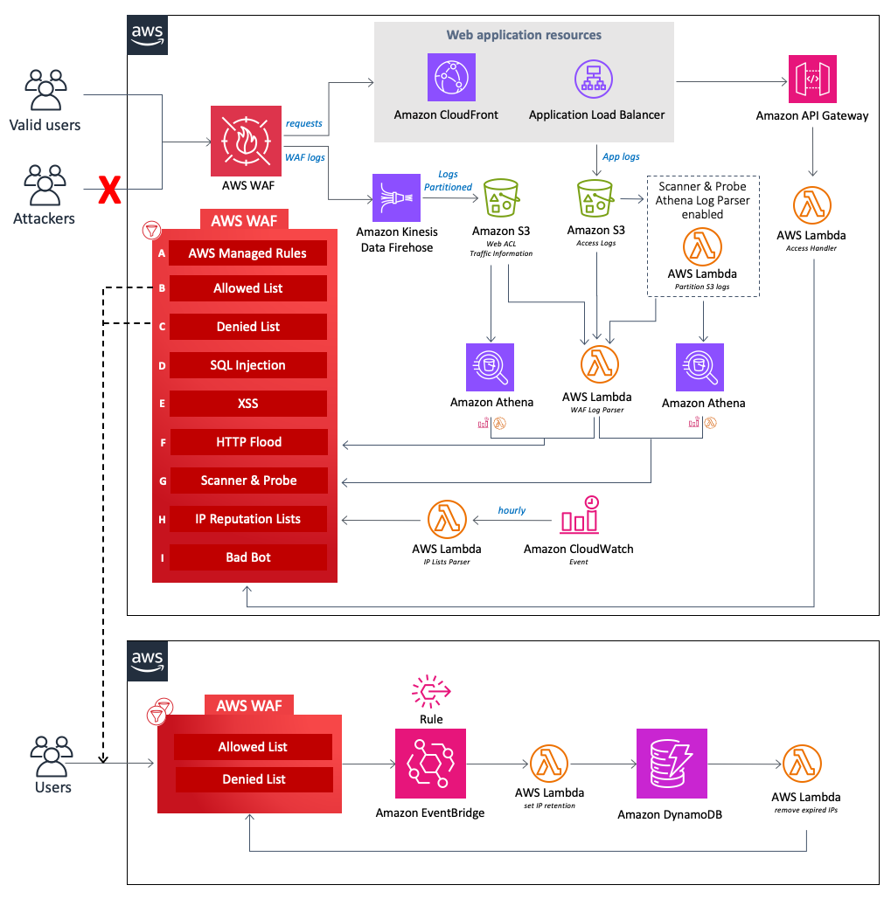
Example AWS WAF

Slide 7
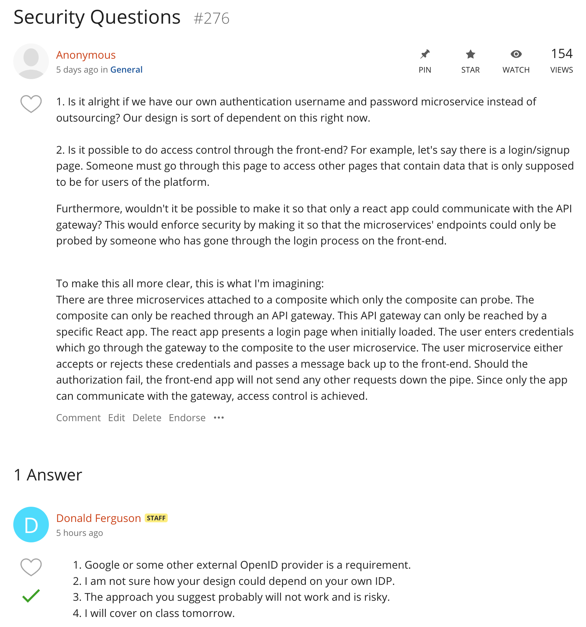
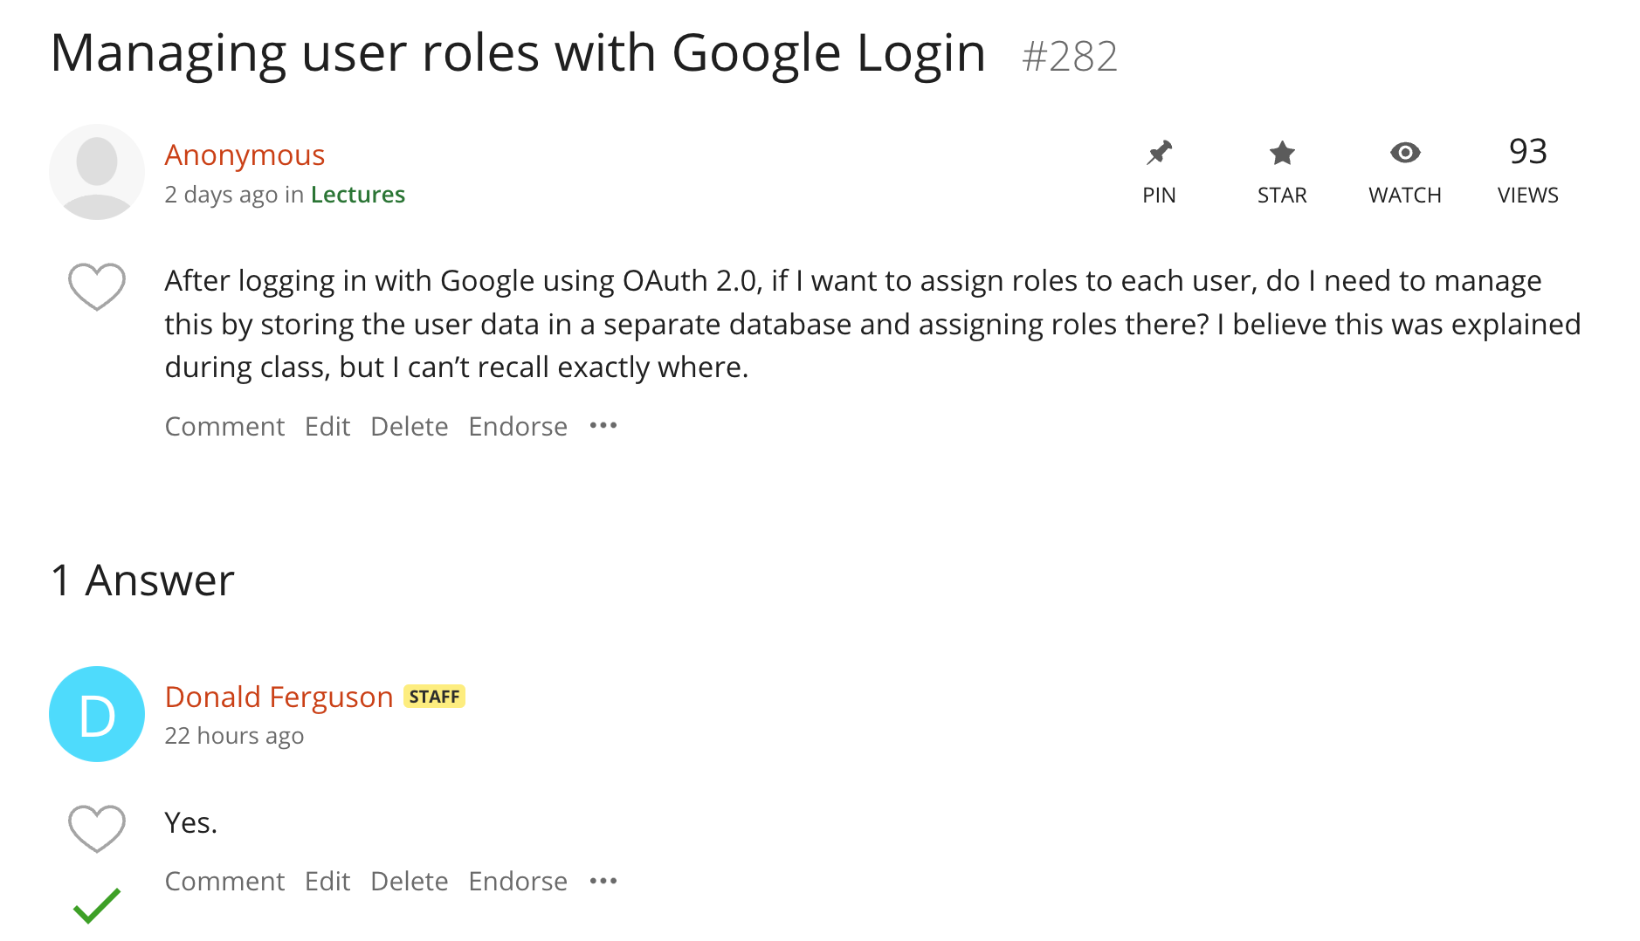
Login and Identity Provider
I briefly covered this in class last week.
A fundamental concept is resource.
The fundamental concept in authorization is a set of rules of the form:
(role, resource, operation)
Remember the SQL GRANT/REVOKE from database class.
You perform the check in middleware or layered service.
The check can be a “database lookup” or generating signed claims during login.

Slide 8
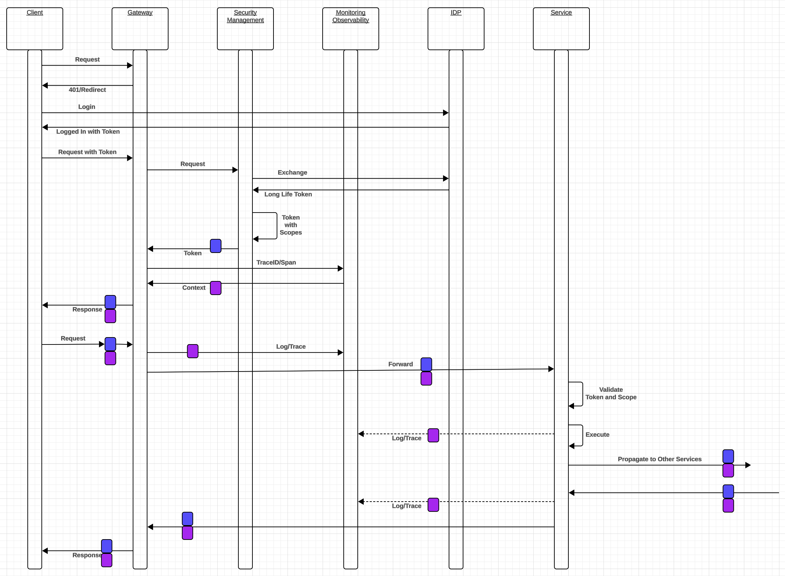
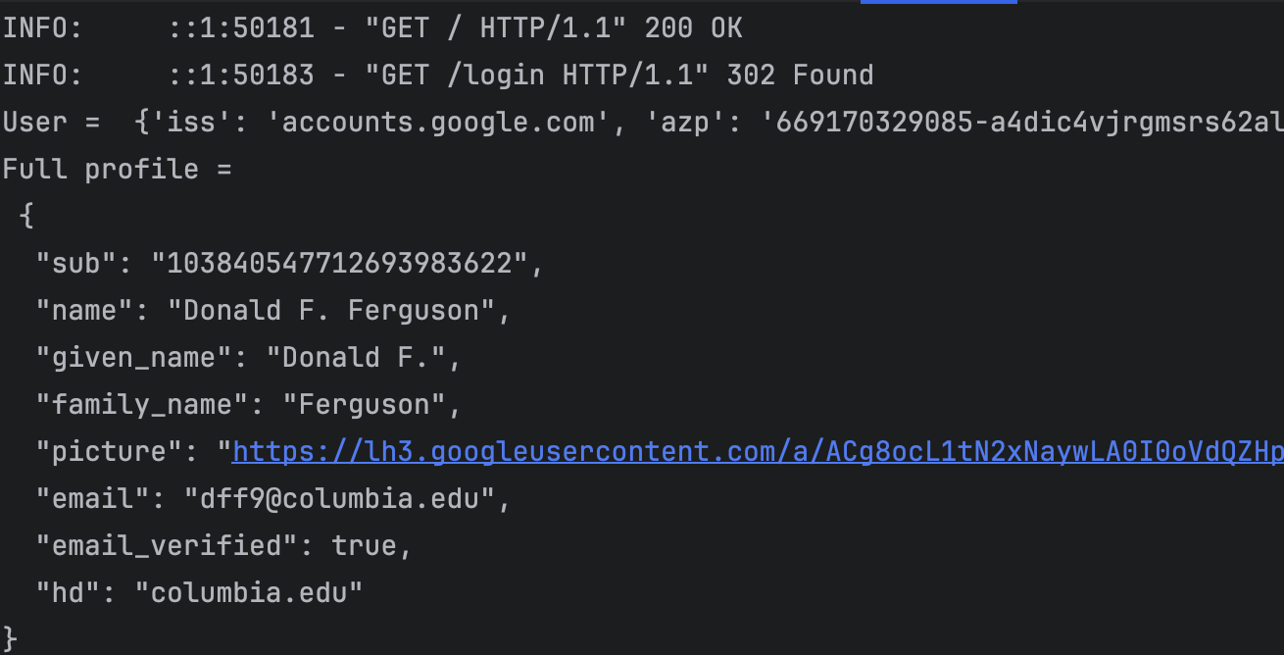
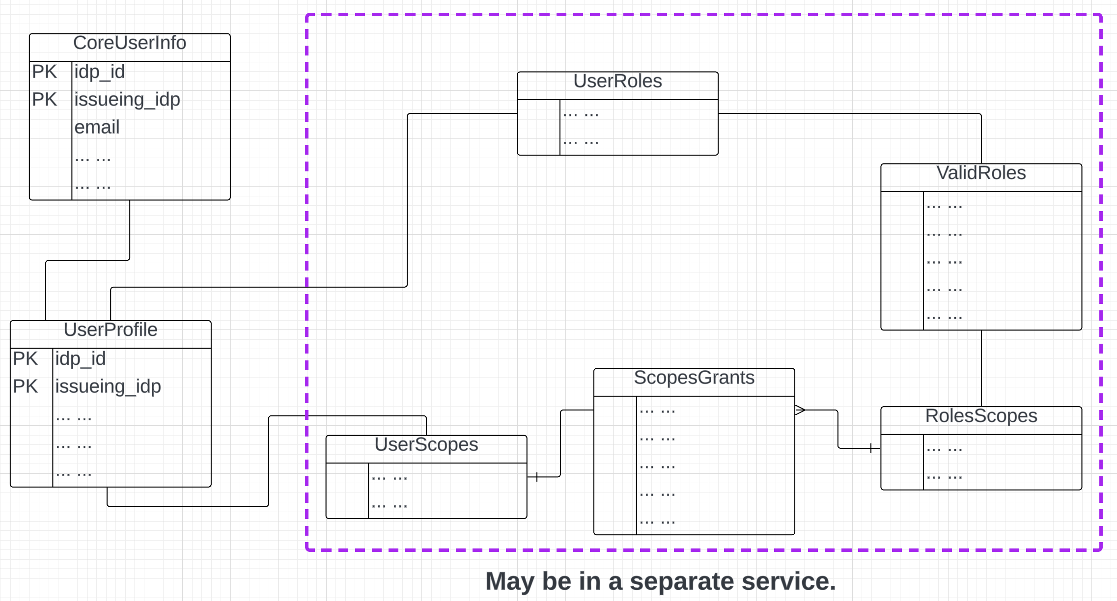
Reminder
See /simple_examples/google_login in course repo.
There are examples, including use of middleware, JWT, … …
Just keep it simple.
In general, each microservice performs the checks.

Slide 9
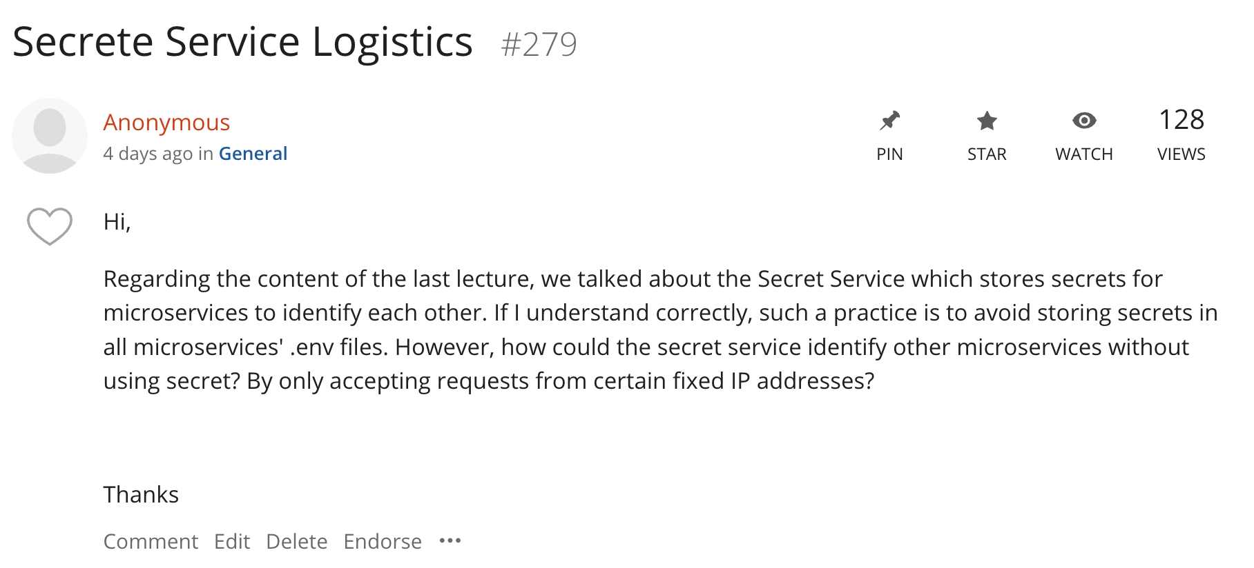
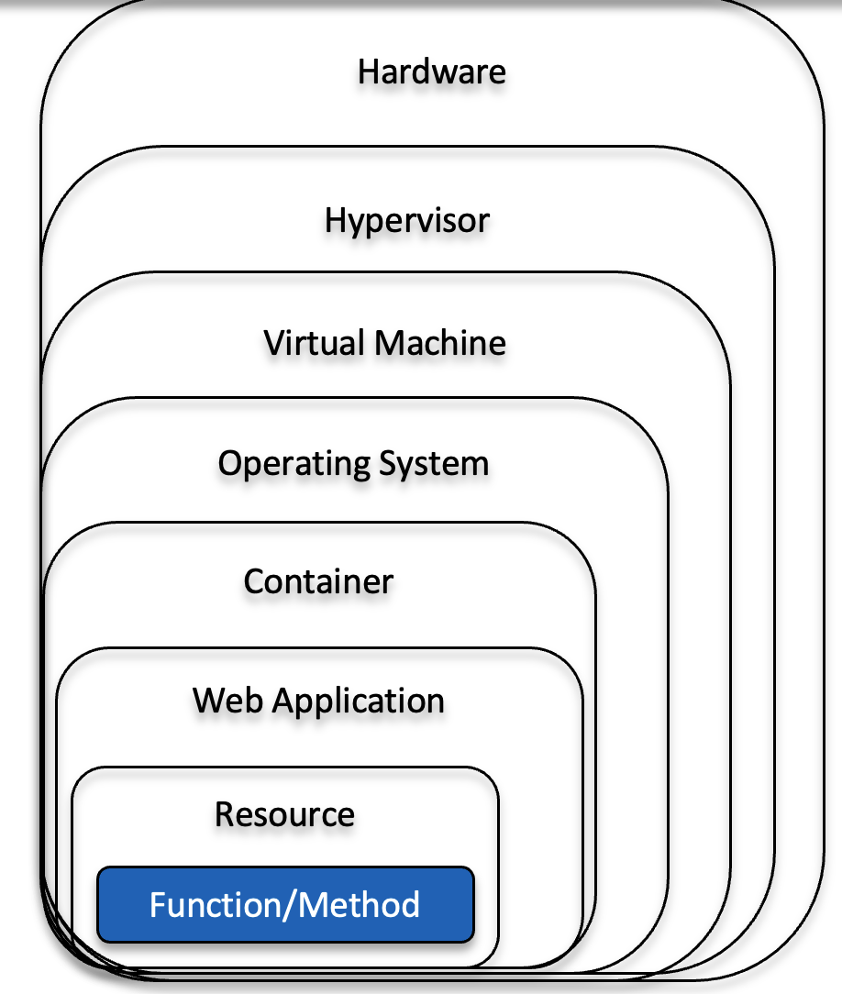
Bootstrapping Credentials
Your code “runs” inside something, which often runs inside something else.
A controller/manager/… launches the ”thing” that contains the code or other things.
“Code” also has an identity, role and corresponding roles.
There are various, “thing specific” ways of configuring, injecting and setting
Identity/credentials for an executing environment.
Environment variables.
… …
You can use something simple, e.g. environment variables set for a VM in the console, … … I did something in the app for issuing your Google tokens.

Slide 10

Computer Models
Hardware
At the very core, you write a function or method.
A set of functions or methods become a resource.
A resource runs in a web application and uses required software, e. g. packages, libraries.
A web application run in some kind of container, which provides isolation, ensures pre-reqs, etc.
Containers run in an operating system.
An operating systems runs on HW, which may be a virtual machine and virtual resources.
Virtual resources run on hypervisors, which
Run on hardware.
This is like a matryoshka doll. Ultimately, I decide:
Which level of nesting is the package I am willing to/want to produce and deploy.
I provide that as a package/bundle and provide a declaration/manifest of what I want created and managed automatically for me.
This is over simplified and the boundaries blur.
Hypervisor
Virtual Machine
Operating System
Container
Web Application
Resource
Function/Method

Slide 11
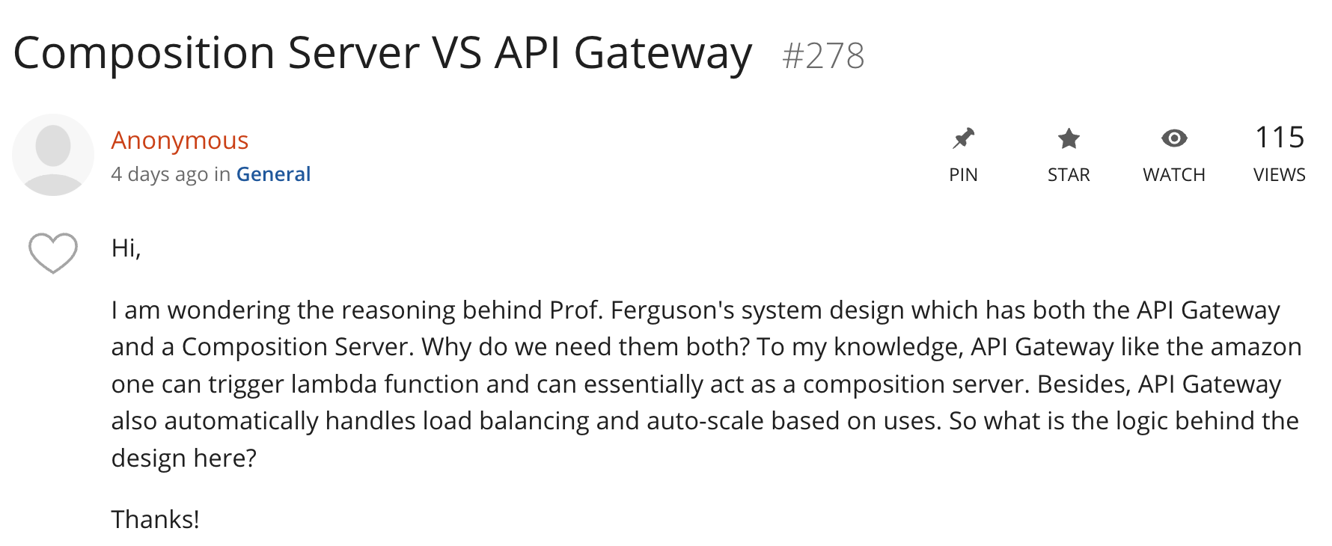
API Gateway versus Composition
First, in your scenario,
The gateway is implementing request routing.
You are implementing the composition service as a bunch of Lambda functions.
Ferguson’s 7th Law of SW Architecture: “A runtime infrastructure must be a floor wax or a mouth wash. Nothing is good at both.”
The functionality/requirements for something that governs and controls a large set of API endpoints and applies complex policies versus something that is good at running complex application logic are vastly different ➔ No “thing” will be good at both.
Composition is a statement about what functions the microservice implements relative to other microservices and is not a statement about “what it runs in.” Composite logic can be relatively complex, especially when errors occur.

Slide 12
Multitenant Applications
12 | W4153-F24-13-Final-Project-MDP/EDA-BPM-Kubernetes-CI-CD-DevOps © Donald F. Ferguson, 2024

Slide 13
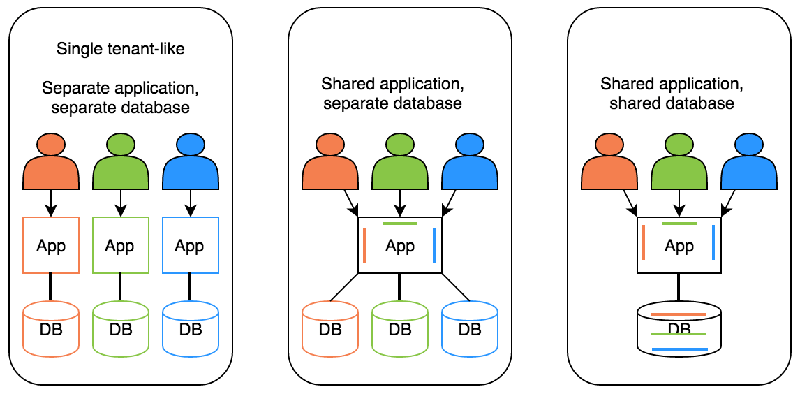
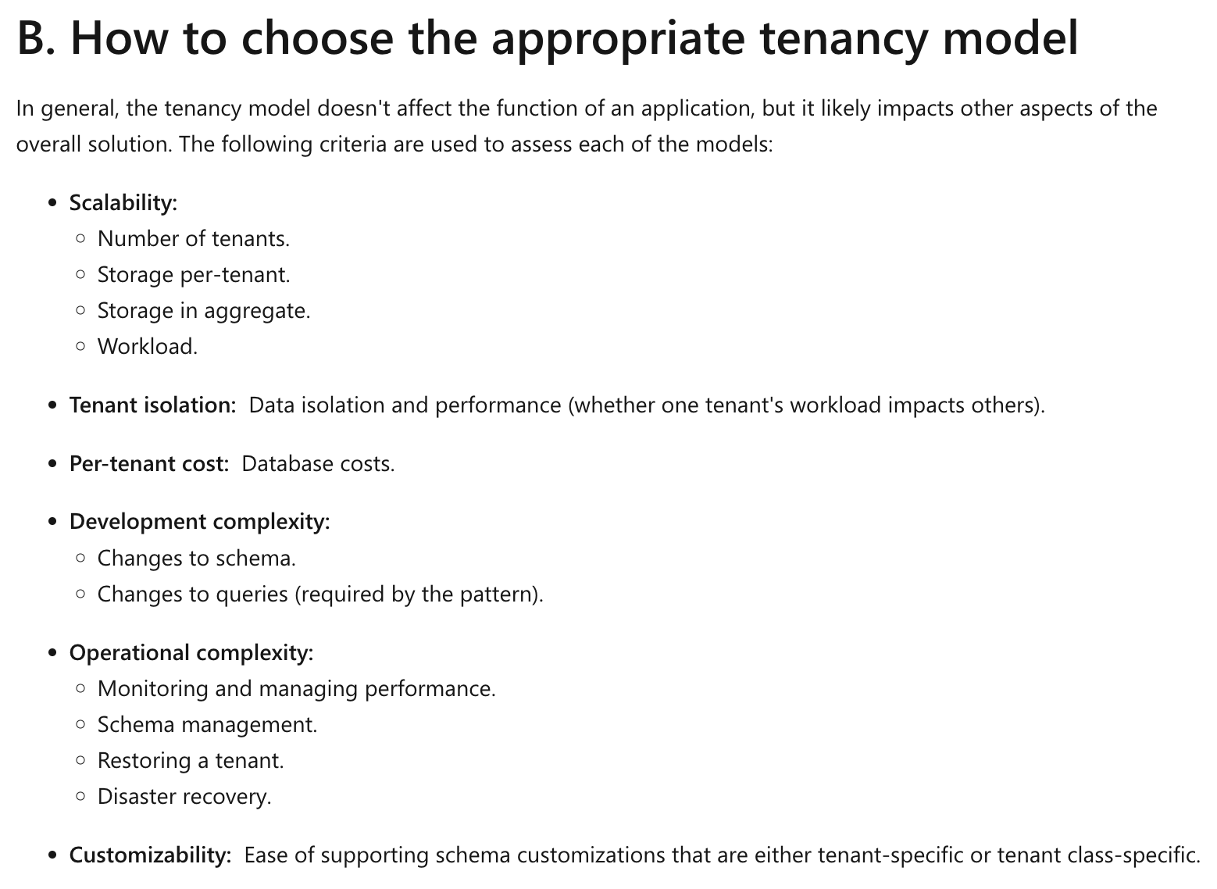
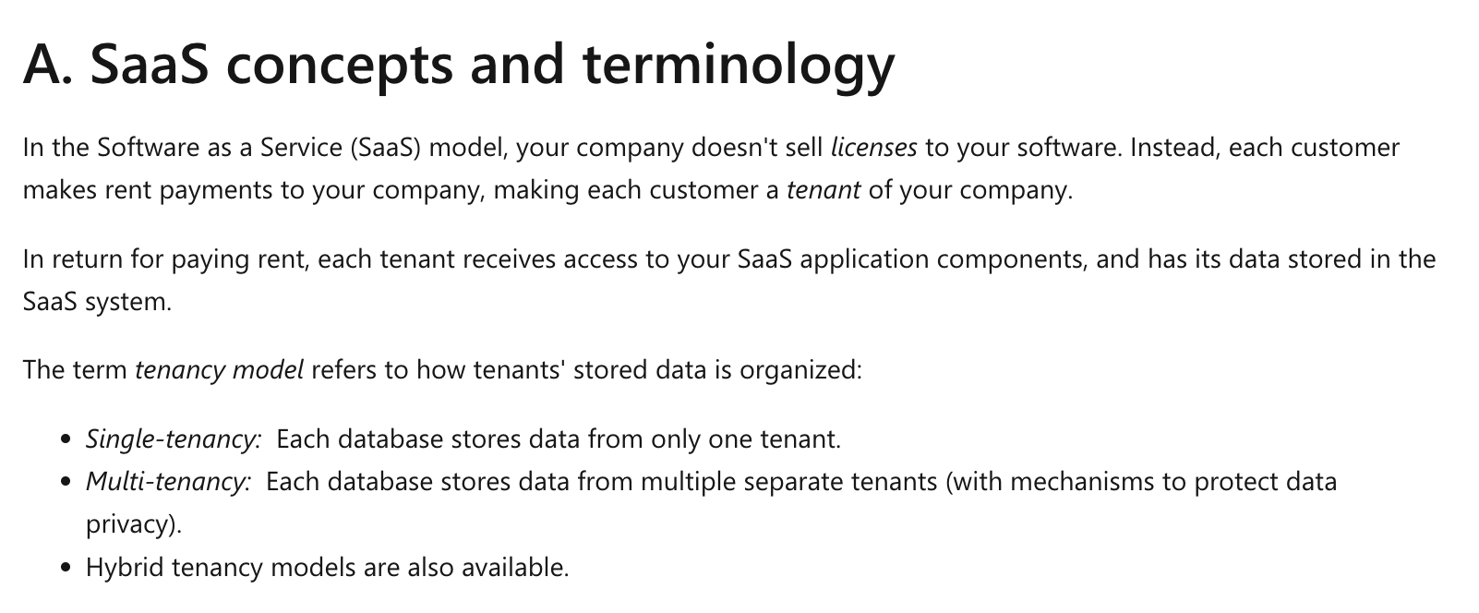
Multitenant Applications
Just be aware.
How to build a multitenant system is a complete semester itself.
No need to include in the project.
https://learn.microsoft.com/en-us/azure/azure-sql/database/saas-tenancy-app-design-patterns?view=azuresql

Slide 14
Final Project Checklist
14 | W4153-F24-13-Final-Project-MDP/EDA-BPM-Kubernetes-CI-CD-DevOps © Donald F. Ferguson, 2024

Slide 15
Initial Final Project Checklist
We will finalize in discussion with TAs, student feedback, etc. Finalizing will include being more precise about requirements.
API gateway with basic routing and authorization check.
Security:
Google login or equivalent.
Issue own JWT tokens with “grants.”
Validate tokens in middleware and propagate on calls to other services.
Observability:
Basic log and trace in microservices.
Correlation ID and propagation.
Middleware.
Demonstrate in a cloud’s logging tools.
At least 3 basic/atomic microservices. There must be at least one microservice deployed:
Directly on a VM.
In a Docker container running on a VM.
Running in PaaS.
REST API:
OpenAPI documents for all microservices.
Documented and followed a basic REST API best practices guidance.
HATEOAS and support for links.
Pagination for at least one microservice.
For POST, at least one microservice should implement 201 created with a link header.
At least one path must implement an asynchronous execution pattern, e.g. 202 Accepted.
At least one composite service that composes the behavior of the atomic services. At least one use of
Composition using code and synchronous API calls.
Composition using code and asynchronous API calls.
Service choreography using pub/sub.
Service orchestration using StepFunctions, workflow, … …
Calling/using at least one external cloud service.

Slide 16
Initial Final Project Checklist
We will finalize in discussion with TAs, student feedback, etc. Finalizing will include being more precise about requirements.
End-user notification – At least one example of
A FaaS reacting to an event.
Some form of end-user notification, e.g.
Discord message
Email
… …
GitHub
A GitHub repository for each microservice.
A project that shows the subordinate microservices.
CI/CD – At least one example of GitHub or other actions that deploys a microservice on commit.
UI/UX
Simple browser web UI
Deployed and delivered from a cloud “blob store.”
CQRS
Simple example of a GraphQL endpoint querying a read only copy of the combined data model.

Slide 17
Advanced Service Composition
17 | W4153-F24-6-REST(4)-OAuth2-Middleware-Composition © Donald F. Ferguson, 2024

Slide 18
Concepts Reminder and Overview
API Gateway
18 | W4153-F24-12-Sample-Project-EDA/MDP-AdvancedCompotion-APIGW-GraphQL-Kubernetes © Donald F. Ferguson, 2024

Slide 19
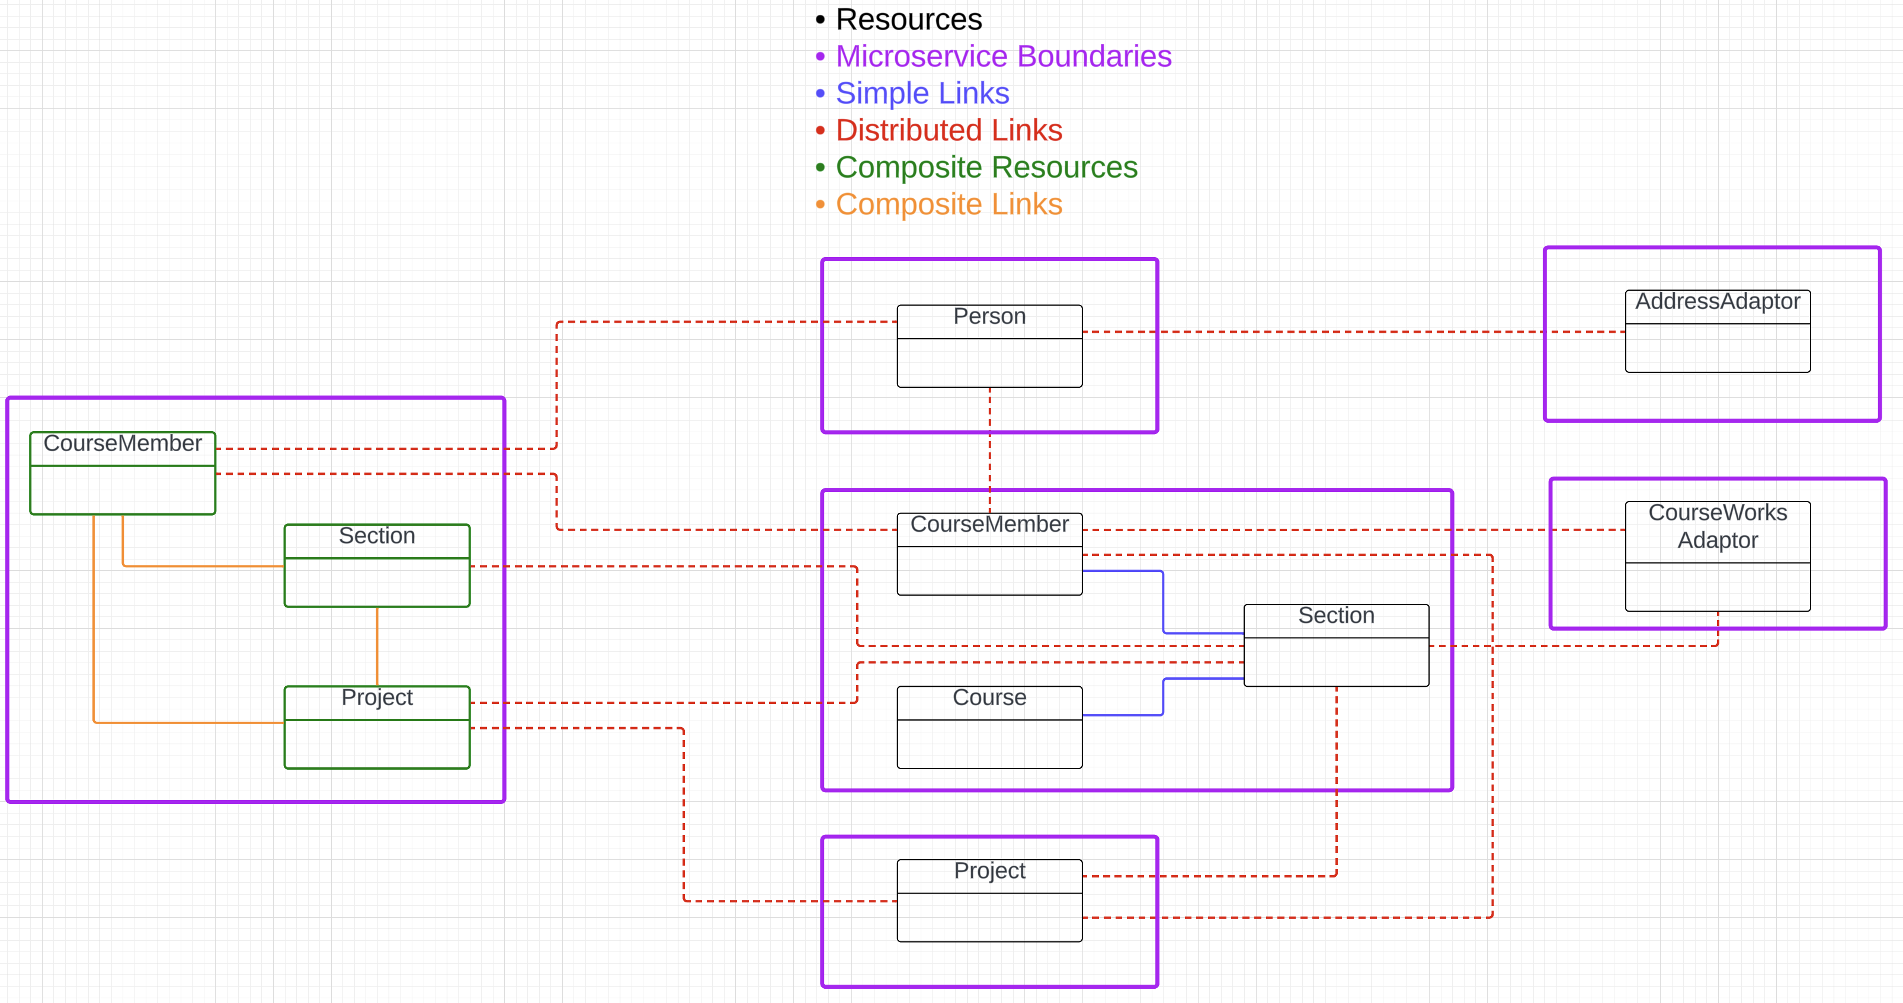
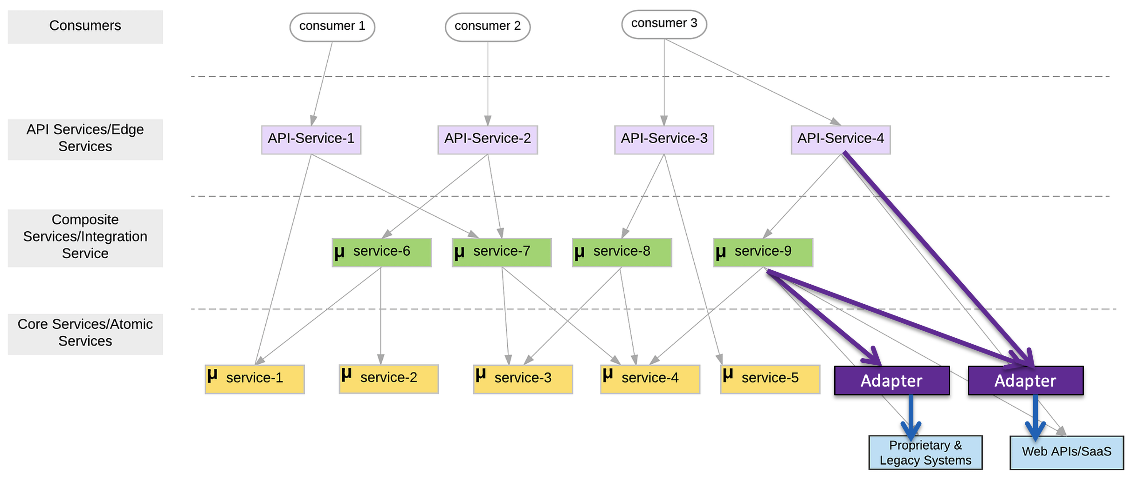
Composition Concepts and Reminder
There are two aspects to “composition:”
Structure: How do I “link things together” to “find services” that a microservice needs?
Behavior: How do I implement the application of logic of the composite?
Two models: Orchestration and Choreography.
Several approaches to implementing the service methods: synchronous code, asynchronous code, event driven architecture, message driven architecture, state machines/workflows, … …
Use pattern like CQRS to “optimize” queries?

Slide 20
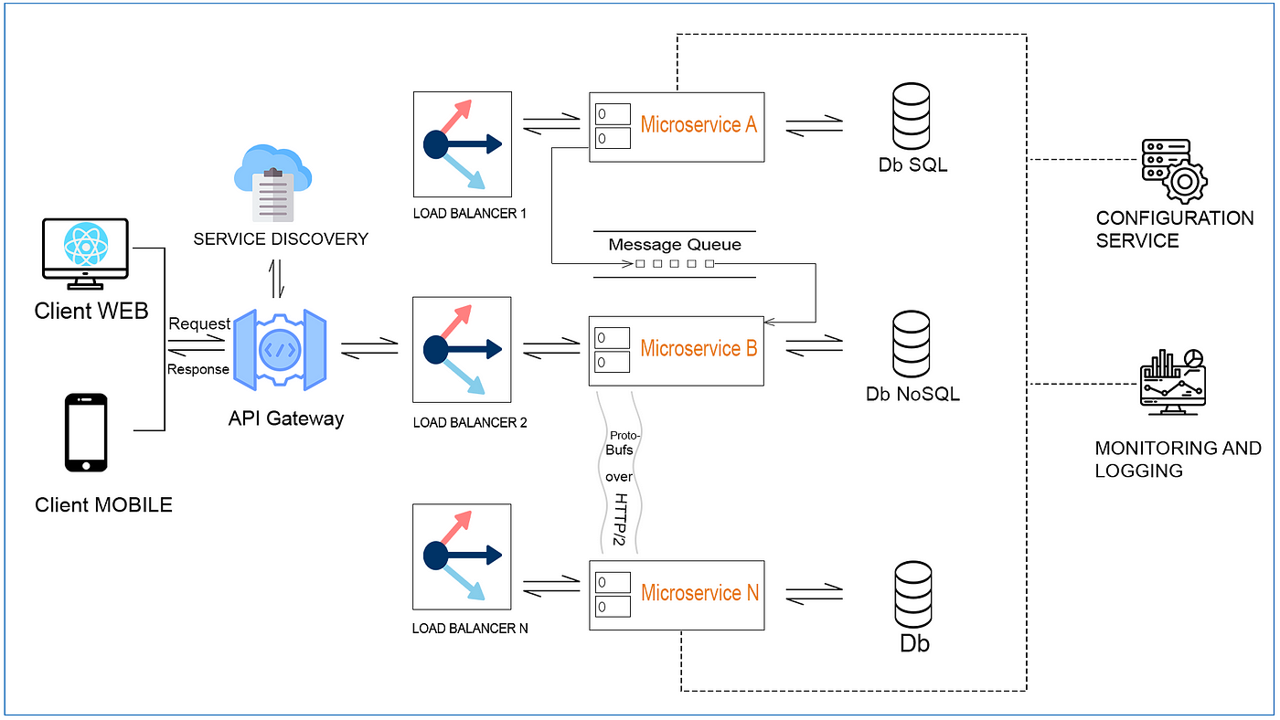
One Approach
https://medium.com/technology-hits/microservices-simplified-8f19b7990fa3

Slide 21
CQRS
and GraphQL
API Gateway
21 | W4153-F24-12-Sample-Project-EDA/MDP-AdvancedCompotion-APIGW-GraphQL-Kubernetes © Donald F. Ferguson, 2024

Slide 22
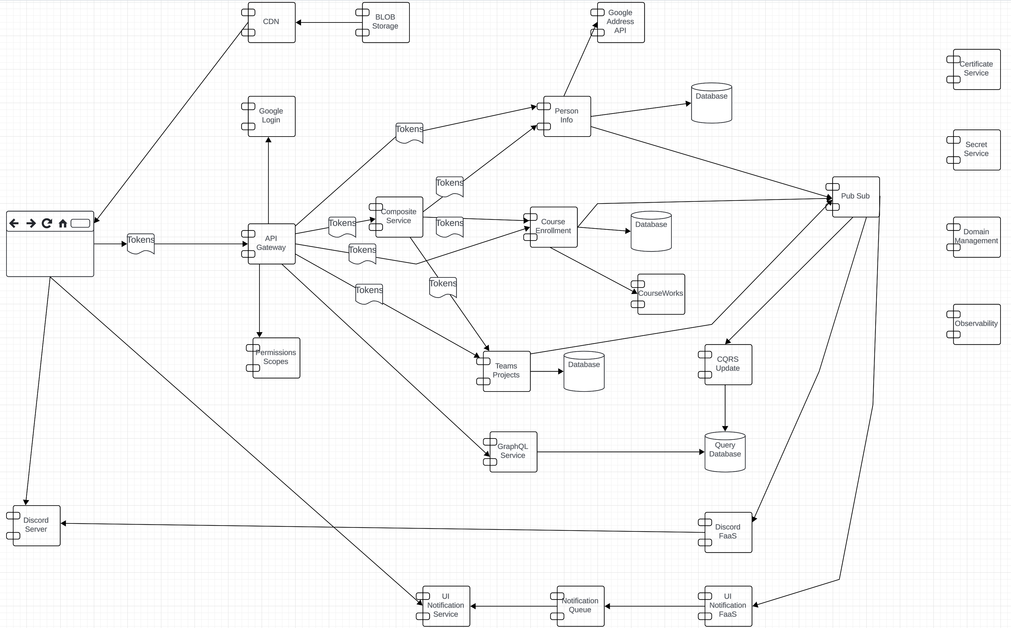
CQRS and GraphQL
What the heck is that stuff?

Slide 23
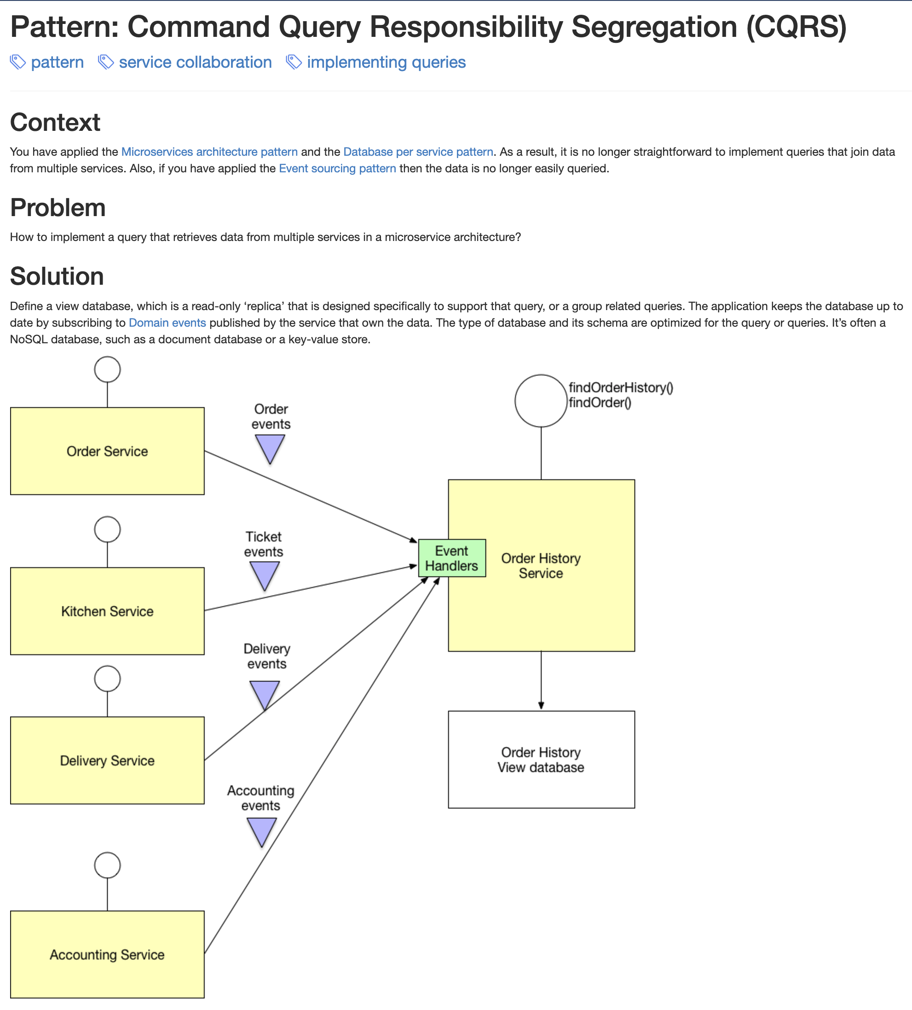
CQRS
We have seen that microservices leads to little bits of “data” all over the place.
Something that a user thinks of as a “thing” is scattered all over the place.
We have seen how to handle this issue using various patterns for composition.
But,
Most of the time things are not changing.
The vast majority of requests are reads.
I would like something more view like and with better query support than just query string in URLs.

Slide 24
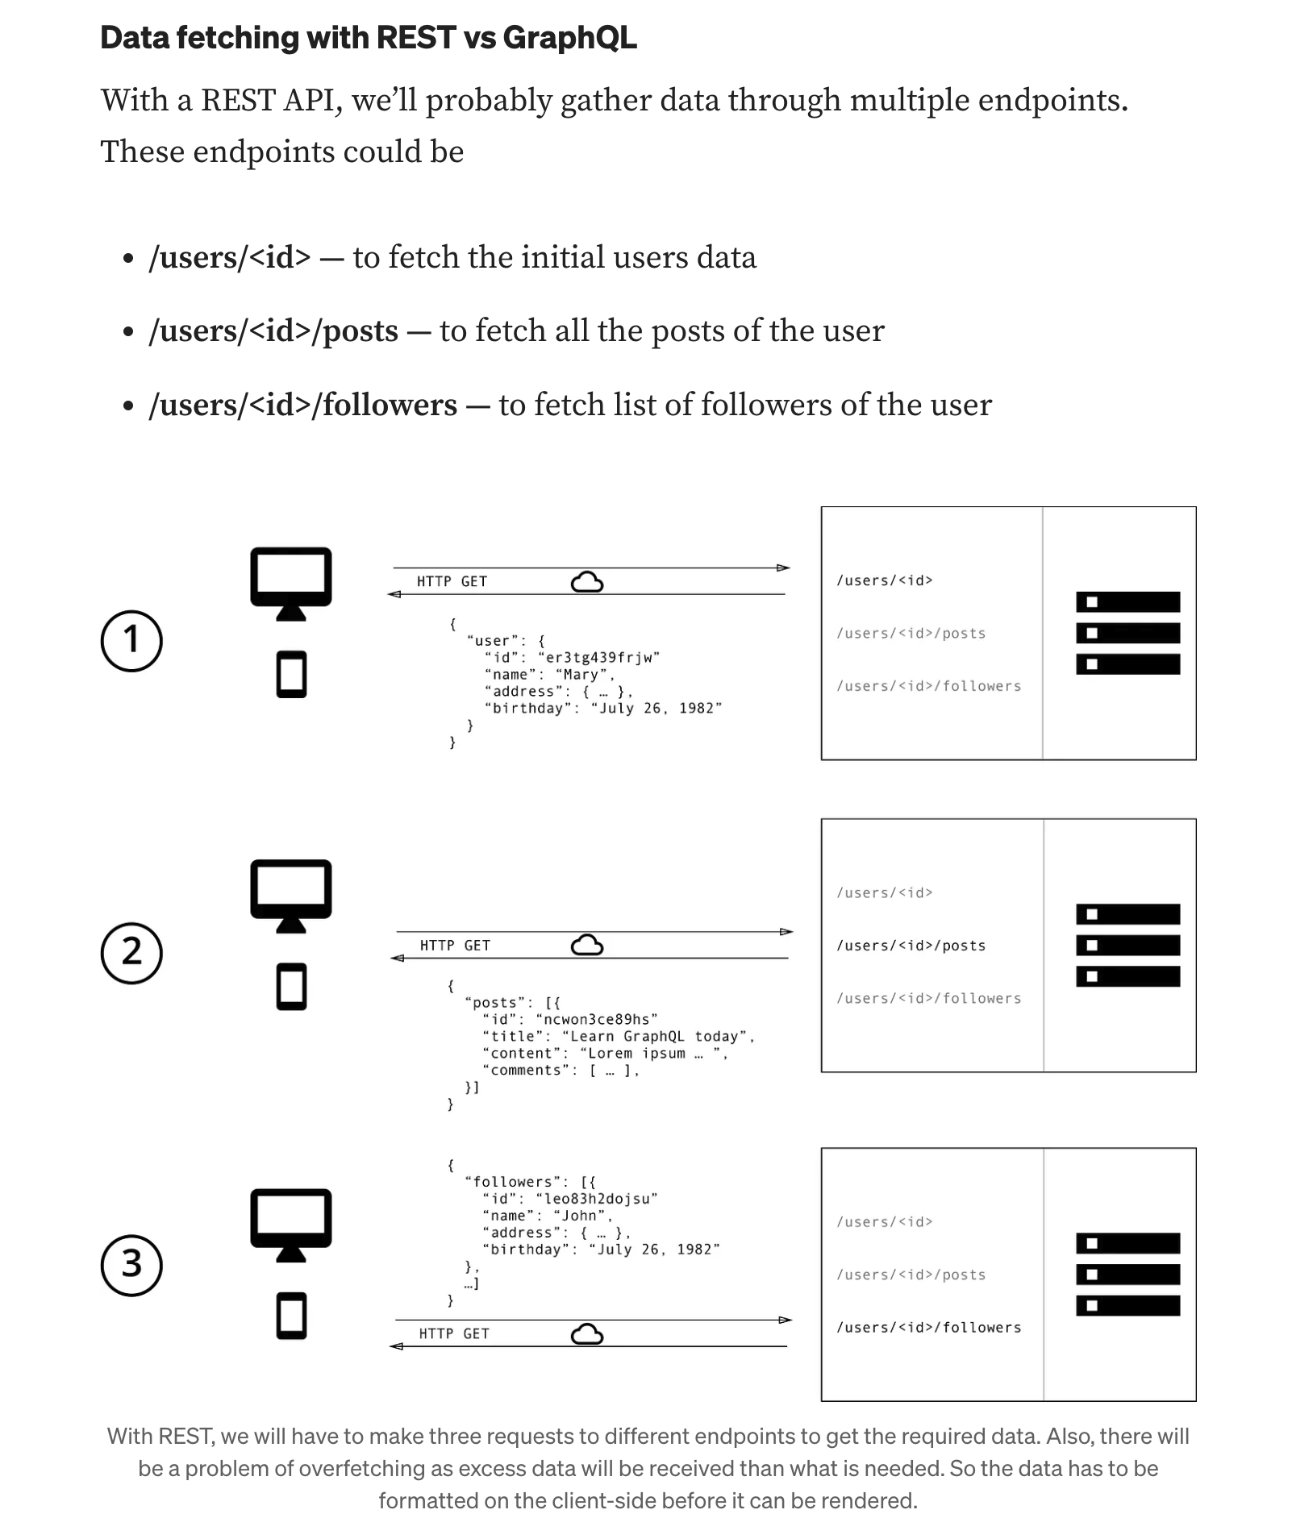
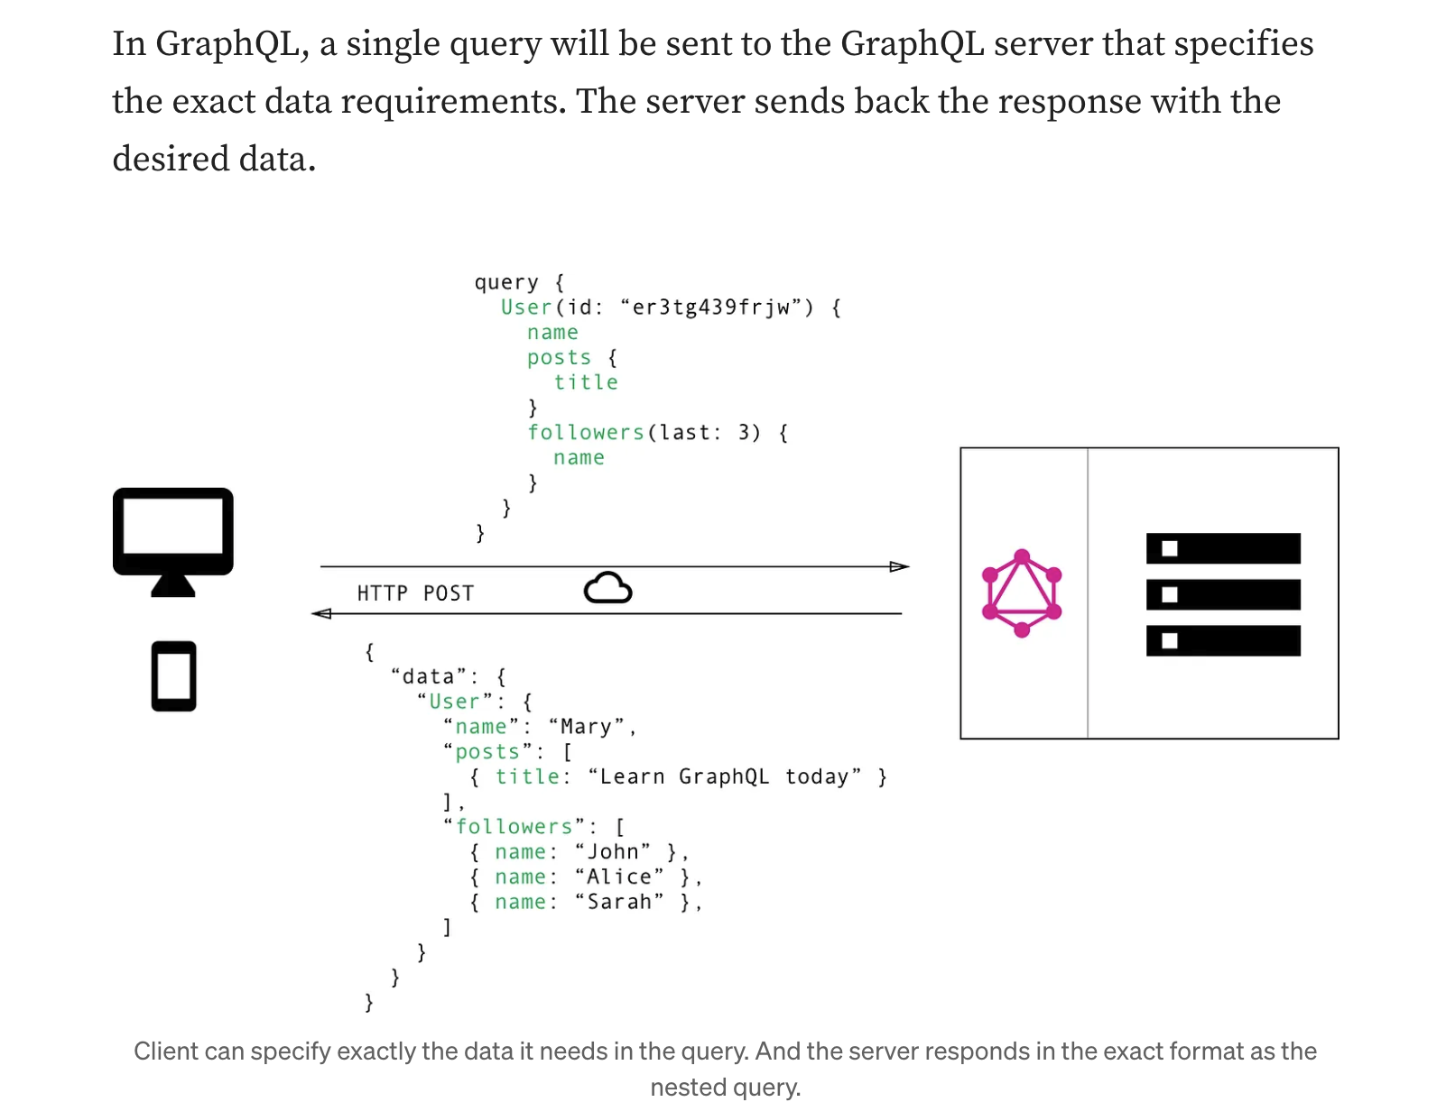
REST vs GraphQL in a Nutshell

Slide 25
GraphQL Concepte
Here are some core concepts in GraphQL:
Schema: GraphQL uses schemas to define the types of operations or queries that can be performed. The schema acts as an interface between the client and the server to fetch or modify data.
Types: GraphQL, like REST, has various data types in an API. These include String, Int, Boolean, or custom object types that the developer defines. Each field of a GraphQL type has its own type. For example, in your GraphQL, the book_name field of the Book type is a String, and the publish_date field is an Int. Is that clear?
Queries: GraphQL is a query language that lets clients specify the shape and content of the data they want from the server. Clients can use GraphQL to request specific fields and nested data in their queries, and the server will respond with data that matches the same structure as the queries. This enables clients to fetch only the data they need, avoiding unnecessary or excessive requests to the server.
Mutations: Mutations are a way of modifying data with GraphQL. Unlike queries, which are mainly for retrieving data from the server, mutations are for creating, updating, or deleting data on the server. Mutations ensure that the data written to the server is predictable.
Subscriptions: Subscriptions in GraphQL enable real-time updates such as notifications. Clients can use subscriptions to listen for specific events or actions on the server. When those events or actions occur, the server sends notifications to the subscribed clients.
Resolvers: A resolver is a function that connects a schema field to a data source, where it can fetch or modify data according to the query. Resolvers are the bridge between the schema and the data, and they handle the logic for data manipulation and retrieval.

Slide 26
GraphQL
Show the GraphQL Overviews
REST vs. GraphQL: A Detailed Comparison of API Architectures for Developers
GraphQL: An Introduction
FastAPI with GraphQL: Delving Deep into Modern API Development
Lectures/W4153-2024F-12-Sample-Project-EDA:MDP-AdvancedComposition-APIGW-GraphQL-Kubernetes/generalpresentation1-180129061029.pdf
How this comes together:
A script (or scripts) creates the query schema and database, and loads the data.
Microservices emit a resource change event via middleware to a topic, e.g. “person_change_event.”
A FaaS instance reacts to the event and updates “the copy.”
Simple, very simple, GraphQL service for query. You only need to do resolvers.
Links in query enable update of the underlying data through the composites.

Slide 27
Updates and Sagas
API Gateway
27 | W4153-F24-12-Sample-Project-EDA/MDP-AdvancedCompotion-APIGW-GraphQL-Kubernetes © Donald F. Ferguson, 2024

Slide 28
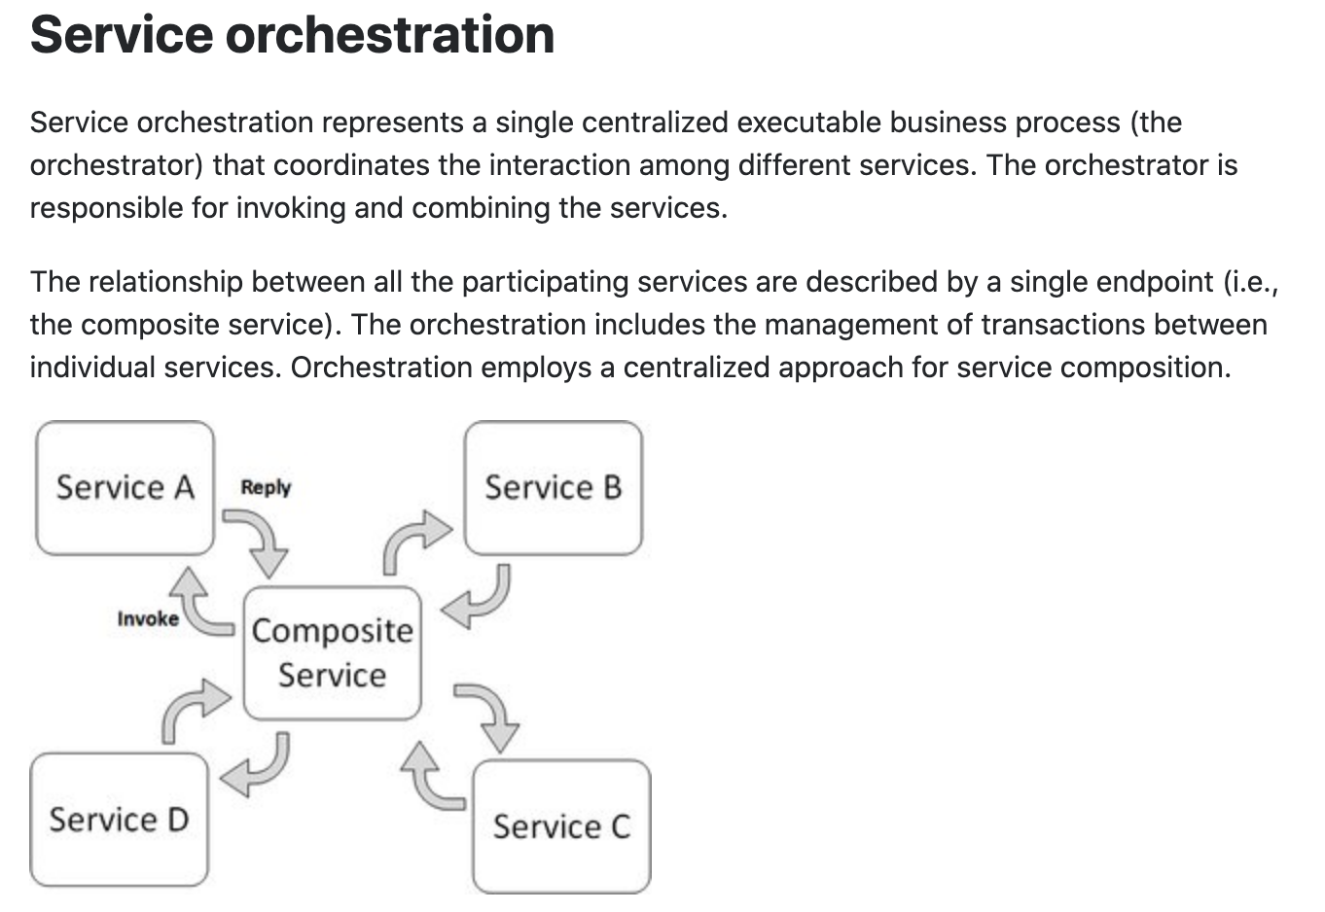
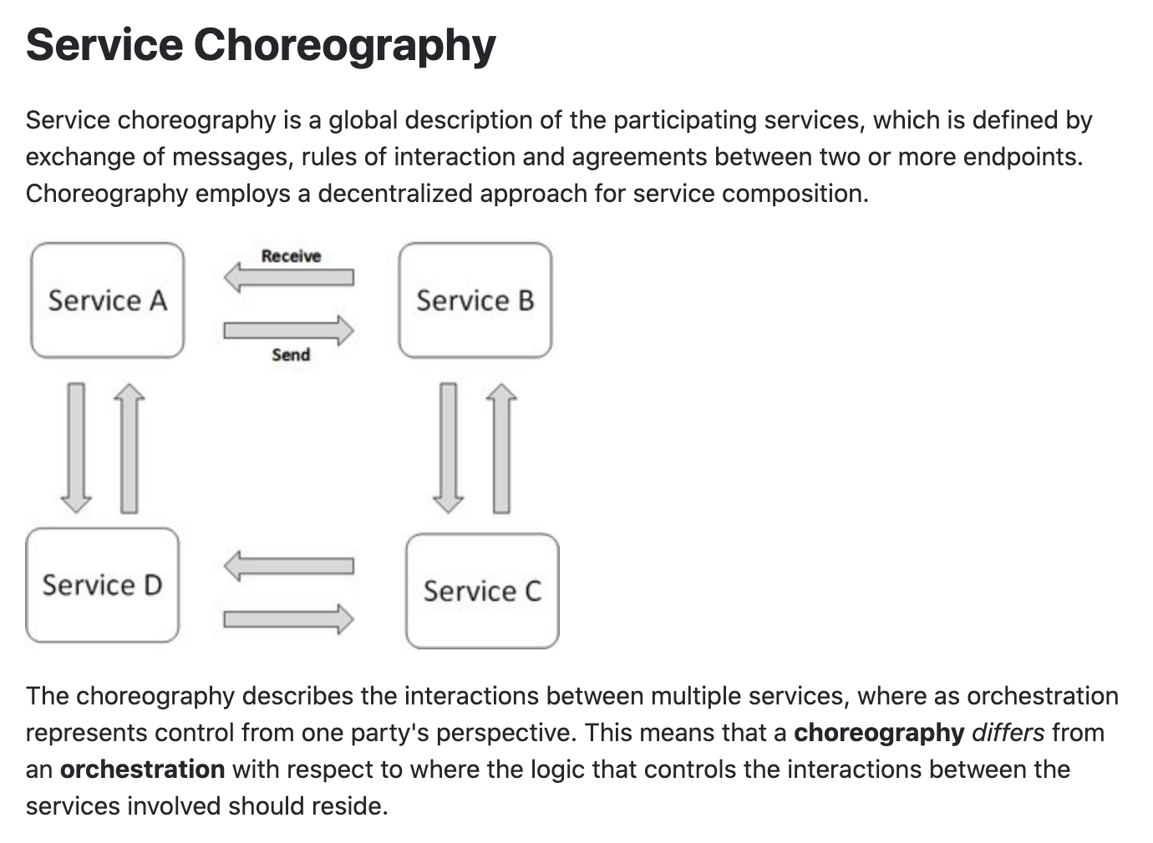
Concepts
These are not formally, rigorously defined terms.

Slide 29
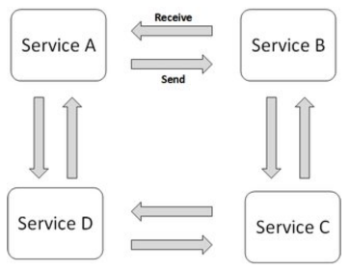
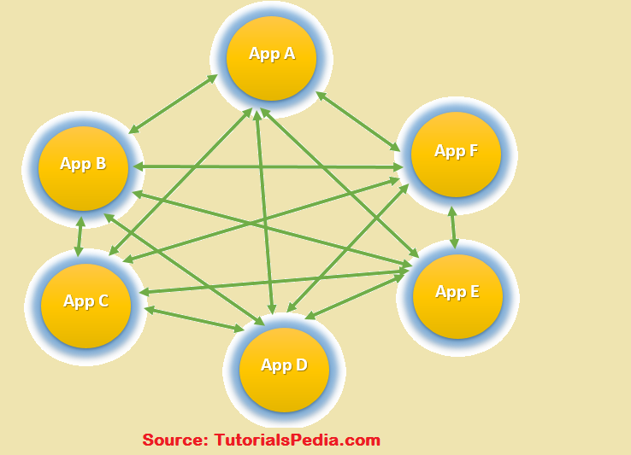
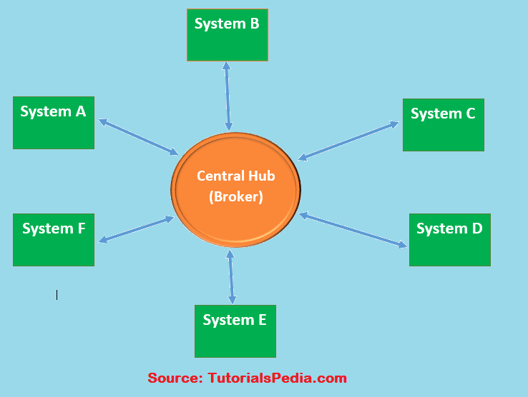
Choreography
We saw the basic diagram, but … this is an anti-pattern and does not scale.
But, how do you write the event driven microservices?
Well, you can just write code … …
Or use a state machines abstraction.
… …

Slide 30
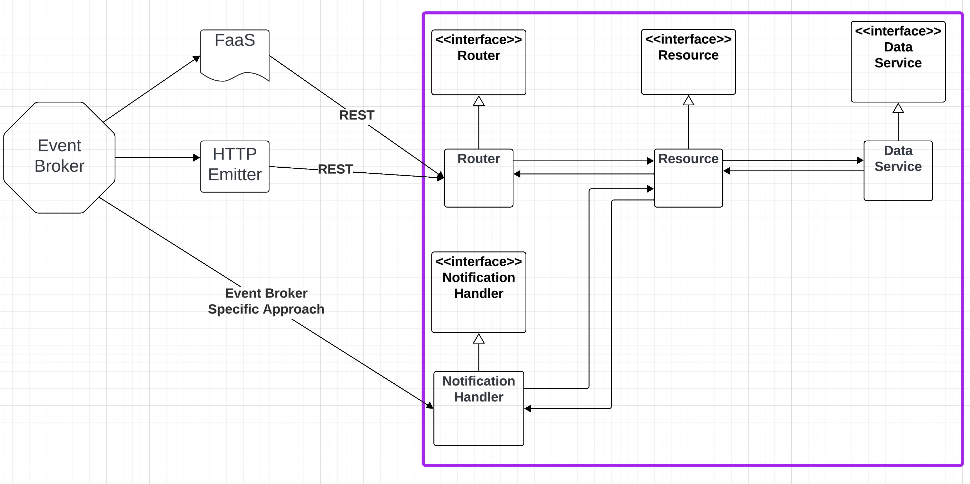
Conceptual Approach

Slide 31
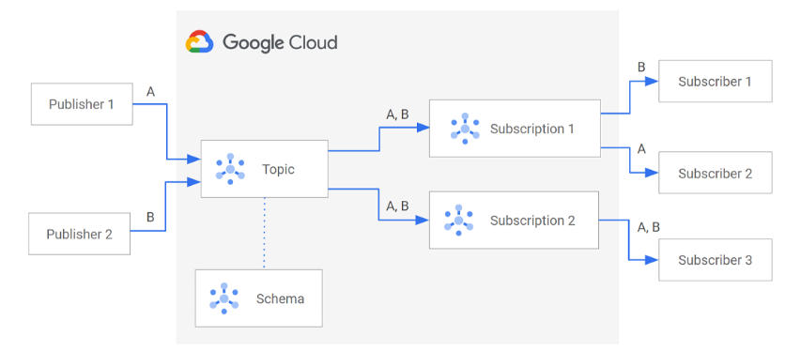
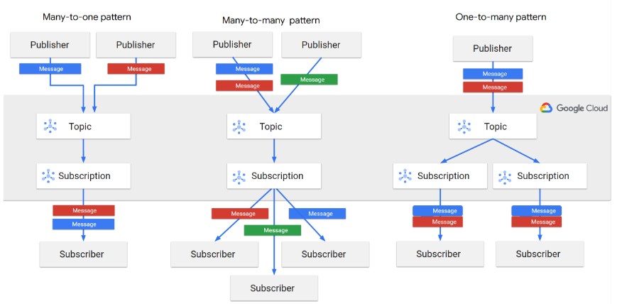
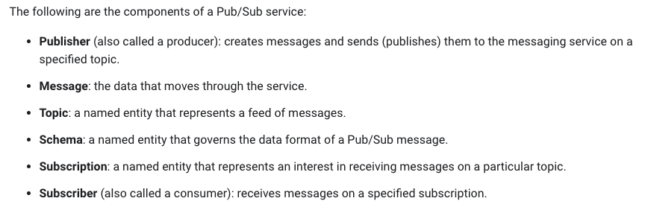
Google Pub Sub

Slide 32
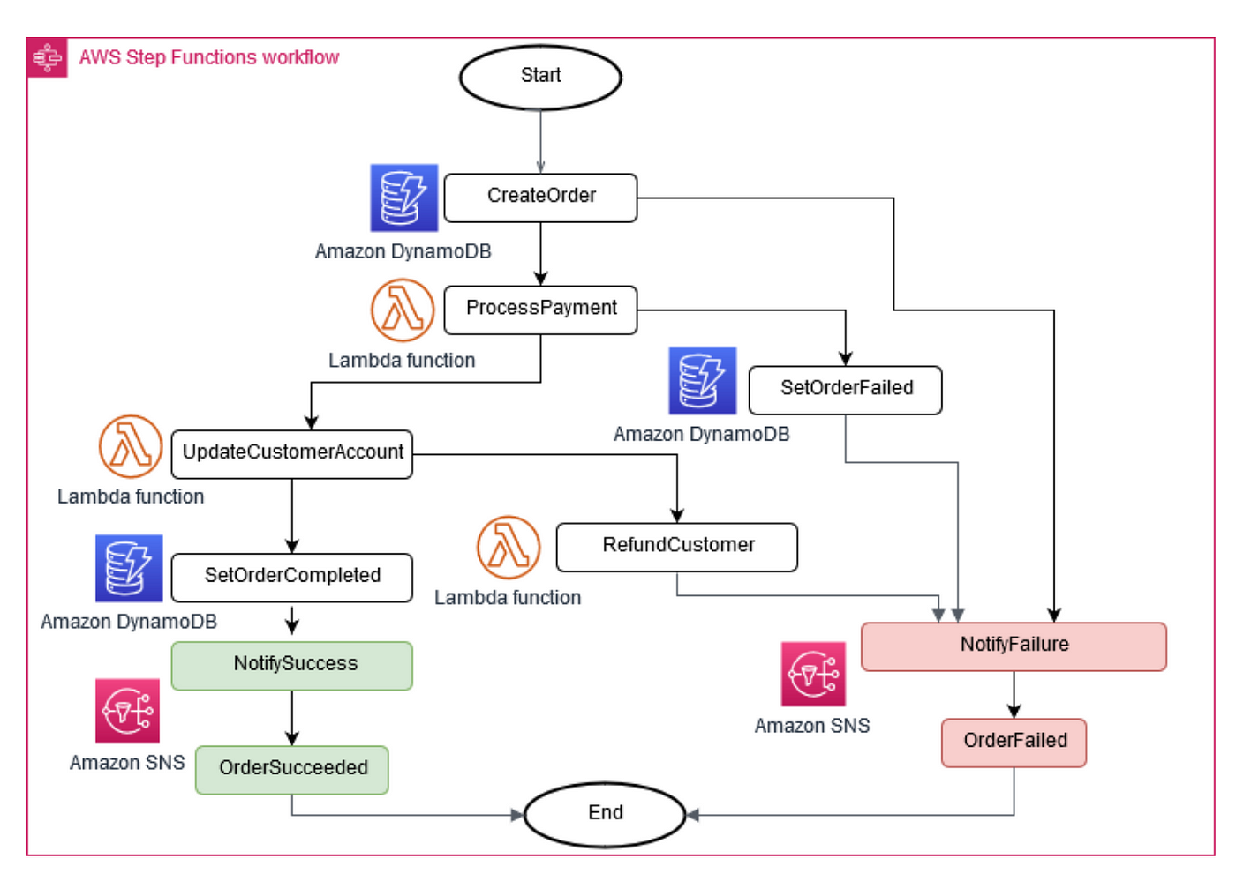
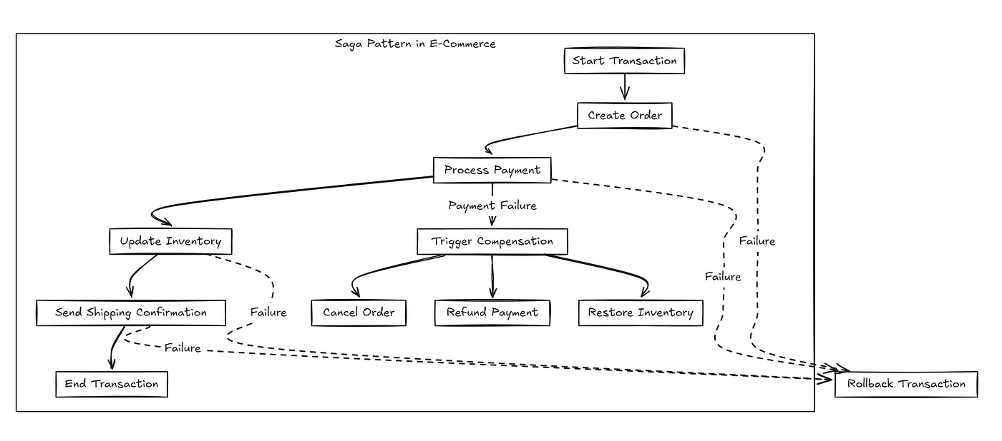
Service Orchestration and Saga
Saga (https://microservices.io/patterns/data/saga.html):
You have applied the Database per Service pattern. Each service has its own database. Some business transactions, however, span multiple service so you need a mechanism to implement transactions that span services.
Implement each business transaction that spans multiple services as a saga. A saga is a sequence of local transactions. Each local transaction updates the database and publishes a message or event to trigger the next local transaction in the saga. If a local transaction fails because it violates a business rule then the saga executes a series of compensating transactions that undo the changes that were made by the preceding local transactions.
There are two ways of coordination sagas:
Choreography - each local transaction publishes domain events that trigger local transactions in other services
Orchestration - an orchestrator (object) tells the participants what local transactions to execute

Slide 33
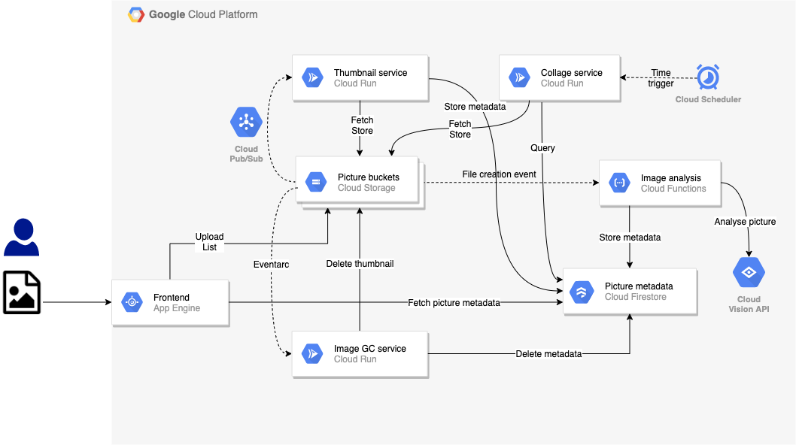
Orchestration
Both Google and AWS have approaches to “workflow” and “orchestration:”
Development and management studios.
High level language.
Execution engine.

Slide 34
Summary
You have implemented composition using code:
Synchronous
Asynchronous
You will do something simple for some composite updates that implements
Choreography
Pub/Sub
Topics
Events and subscriptions
”Do” and “Rollback” functions
Orchestration with compensation using one of the engines
Access via an API
Something very simple

Slide 35
DevOps
35 | W4153-F24-13-Final-Project-MDP/EDA-BPM-Kubernetes-CI-CD-DevOps © Donald F. Ferguson, 2024

Slide 36
Some Terminology (From Wikipedia)
DevOps is a methodology in the software development and IT industry. Used as a set of practices and tools, DevOps integrates and automates the work of software development (Dev) and IT operations (Ops) as a means for improving and shortening the systems development life cycle. DevOps is complementary to agile software development; several DevOps aspects came from the agile way of working.
In software engineering, CI/CD or CICD is the combined practices of continuous integration (CI) and continuous delivery (CD) or, less often, continuous deployment. They are sometimes referred to collectively as continuous development or continuous software development. Components:
Continuous integration: Frequent merging of several small changes into a main branch.
Continuous delivery: Producing software in short cycles with high speed and frequency so that reliable software can be released at any time, with a simple and repeatable deployment process when deciding to deploy.
Continuous deployment: Automatic rollout of new software functionality.
Infrastructure as code (IaC) is the process of managing and provisioning computer data center resources through machine-readable definition files, rather than physical hardware configuration or interactive configuration tools. The IT infrastructure managed by this process comprises both physical equipment, such as bare-metal servers, as well as virtual machines, and associated configuration resources.

Slide 37
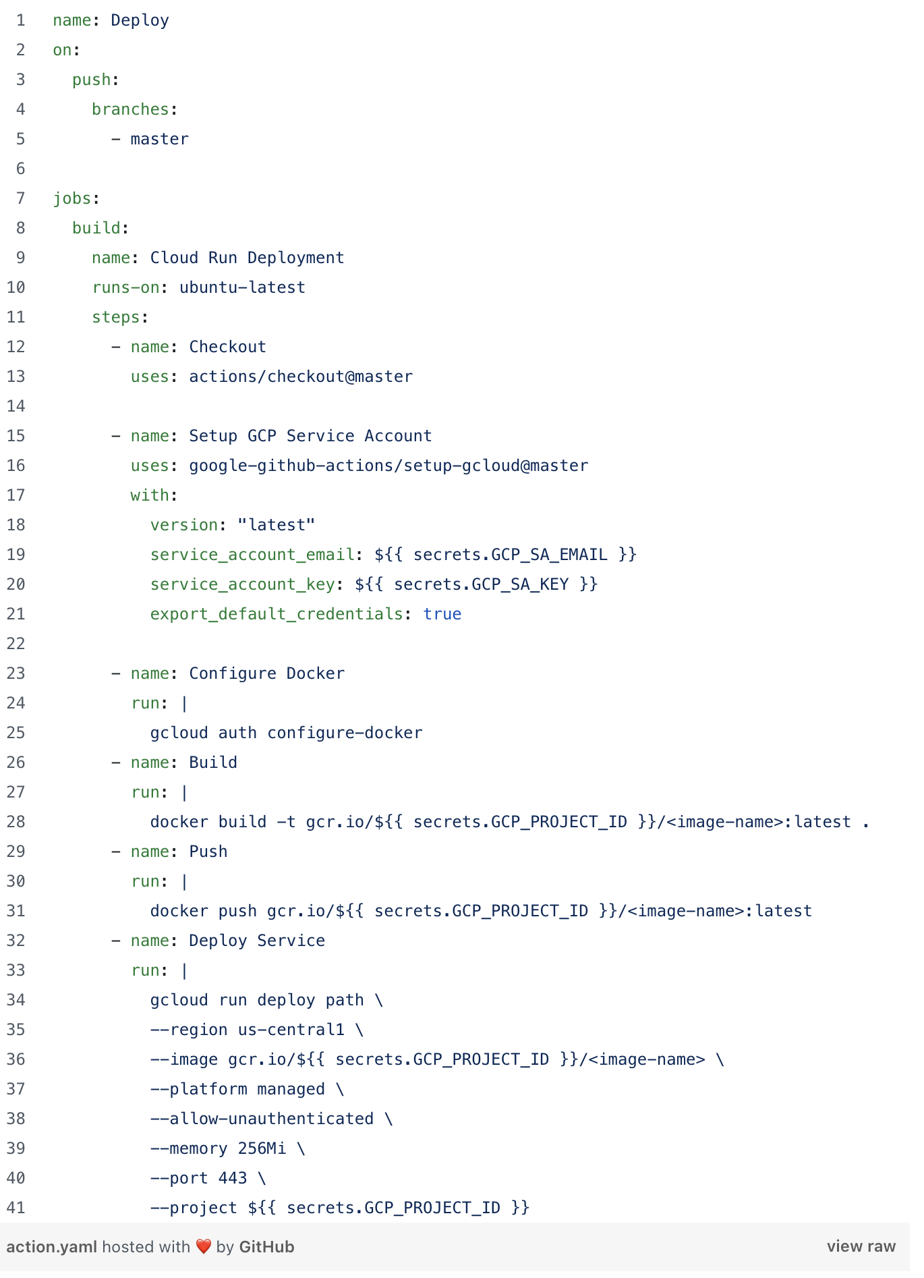
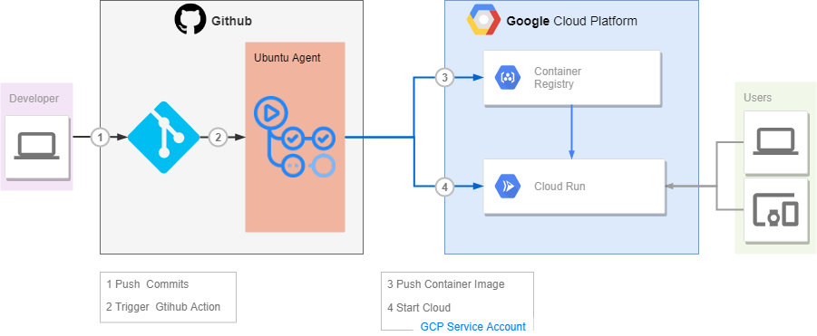
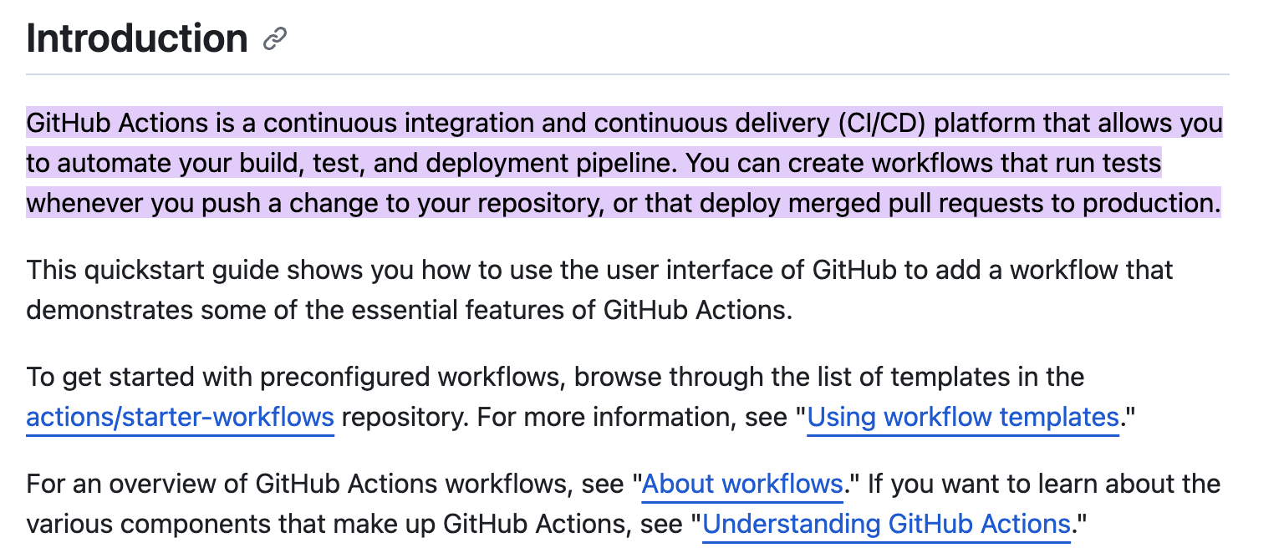
GitHub Actions

